Slide 1
Graduation Project Presentation
Track:ERP ( Oracle Digital Accounting)
Student’s names:
Zeinab Magdy Asran
Ahmed Mahmoud Mohammed
Mohamed waled Abdel Hamid
Abdul-Rahman Ali Mohamed

Slide 2
General Ledger Operations and Financial Reporting in Oracle ERP Objective

Slide 3
The main objective of “General Ledger Operations and Financial Reports in Oracle Enterprise Resource Planning (ERP) project is to streamline and enhance financial management processes Within the organization.
This includes implementing a general ledger system that facilitates
To comply with recognized rules and principles, accounting means such as International Financial Reporting Standards (IFRS) or Generally Accepted Accounting Principles (GAAP). This compliance aims to ensure the accuracy, reliability and reliability of financial statements, facilitating economic decision-making and enhancing investor and user confidence in financial statements.
All this aims to manage money in an organized and transparent manner.
Goals of the project

Slide 4
This project involves the configuration and improvement of the general ledger within Oracle ERP to support various financial processes. The main activities include:
Data integration: ensuring smooth integration of financial statements from different sources to the general ledger
Designing the chart of accounts: Preparing a comprehensive chart of accounts that reflects the financial structure of the organization.
Transaction processing: Financial transaction management including journal entries, reconciliations and period-end closures.
User training: Training employees on the new system to ensure effective use and adherence to best practices
Financial Reporting: Develop customizable financial information reports to provide insights into financial performance and compliance.
Regulatory compliance: Ensure that financial processes meet the relevant accounting standards and regulations.
The main objective of the project is to improve the accuracy, efficiency and transparency in financial reporting and operations.
Description of the project

Slide 5
Improve operational efficiency: Helps reduce the time and effort required to manage financial records and prepare reports.
Increased accuracy: Ensures that errors in financial statements are reduced, which enhances confidence in the information used in decision-making.
Decision support: Provides accurate and timely financial information, which helps management make better strategic decisions.
Enhancing transparency: Enables stakeholders to obtain clear and detailed financial reports, which facilitates audits and audits.
Compliance with standards: Ensures that the organization adheres to accounting standards and laws, which reduces legal risks.
In general, the project aims to improve the financial performance of the organization and increase its competitiveness.
The business of General Ledger Operations and Financial Reporting in Oracle ERP Objective

Slide 6

Journal Entries and Daily GL Operations

Slide 7
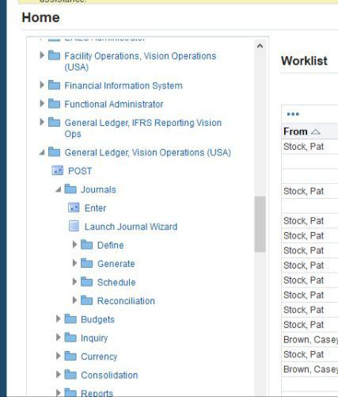
1)Create and Post Manual Journals:
To Create and Post Manual Journals in Oracle ERP for General Ledger Operations and Financial Reporting, follow these steps:
General ledger,vision operations (USA)> journals>enter

Slide 8
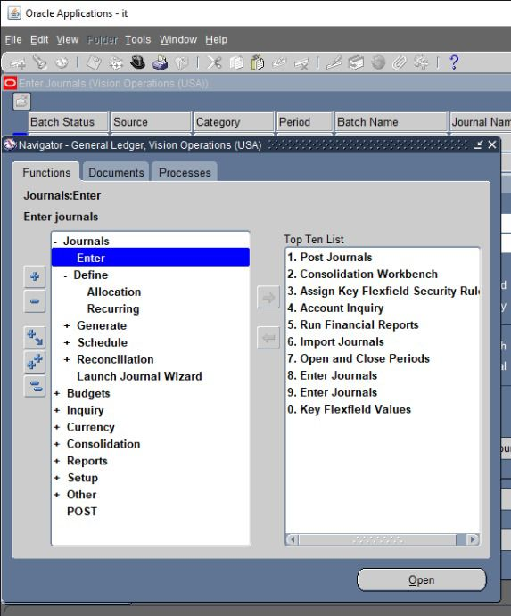
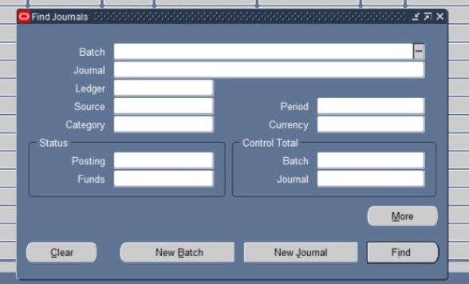
New journal
Journals>enter

Slide 9
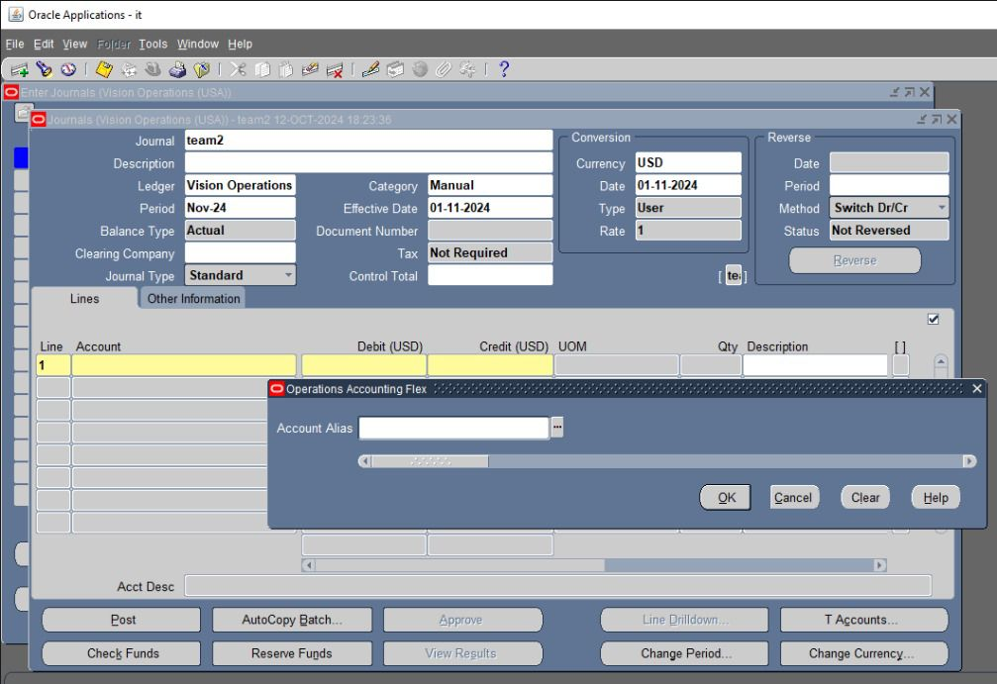
Enter Journal Header Information In the Journal Header, enter the following:
Journal:Enter the journal entry name
Ledger: Choose the appropriate ledger.
Journal Category: Select a category (e.g., accruals, adjustments).
Journal Date: Enter the date of the transaction.
Journal Description: Provide a brief description.
Currency: Enter the journal entry currency Enter Journal Line Information
In the Journal Lines section:Input the Account for each line (debit and credit).
Enter the Debit or Credit amounts.
Add any additional information, such as Descriptions for each line.

Slide 10
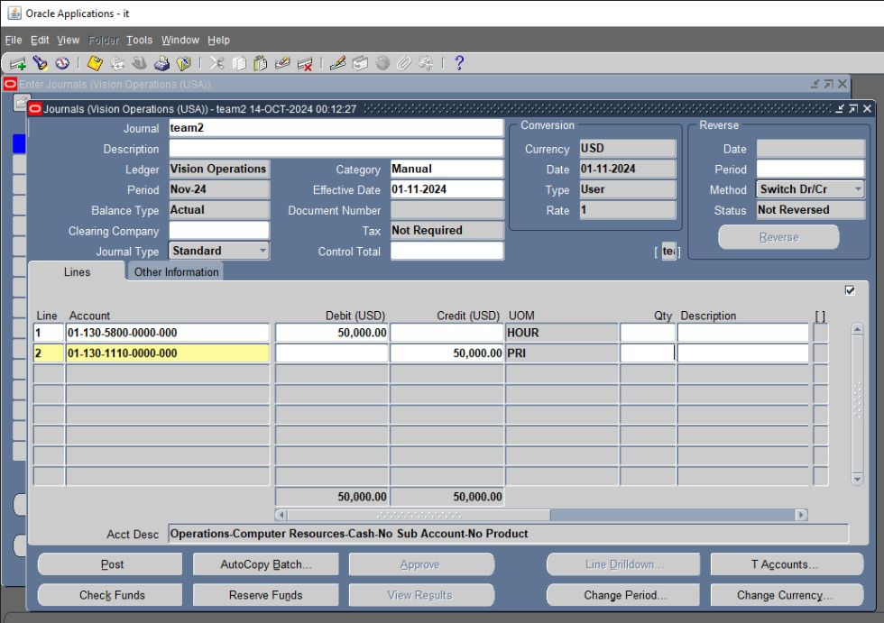
1-2)Validate the Journal:
Once all lines are entered, click Validate to check for errors. If there are no errors, the journal is marked as valid
The journal entry must be correct and balanced. If it is not balanced, the system will allow entry but will reject posting
Post the Journal :
After validation, click Post to post the journal to the ledger. This action updates the general ledger balances

Slide 11
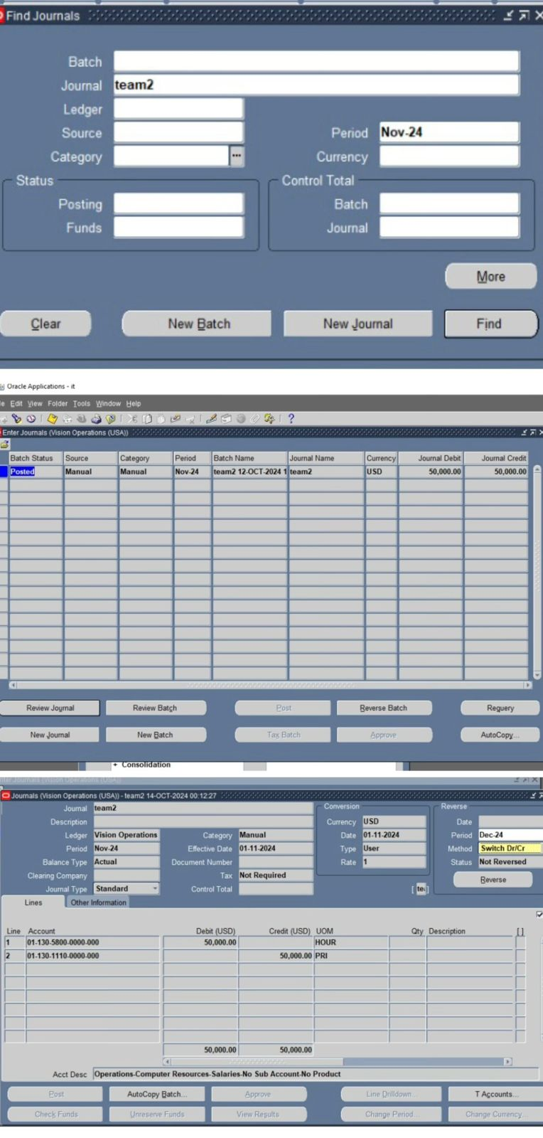
can search for the journal entry by name and period. Then, click Find followed by Review Journal, and the posted journal entry details will appear

Slide 12
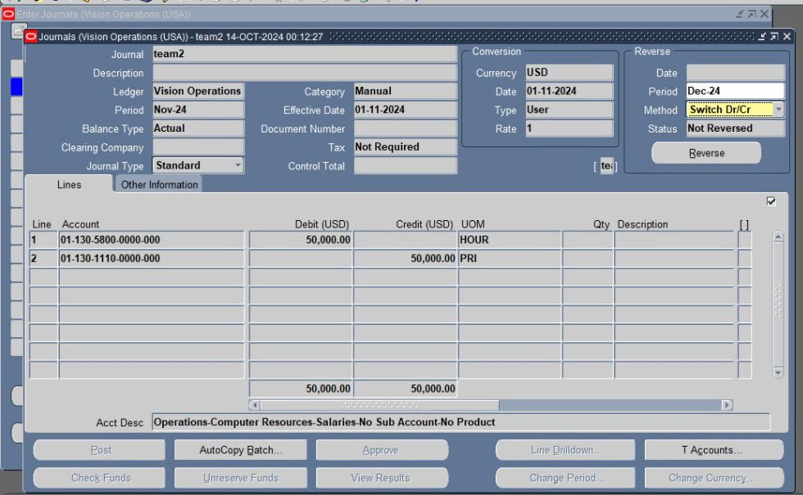
To Create and Post Reversing Journals in Oracle ERP for General Ledger Operations and Financial Reporting,
follow these steps:
Choose the Reversal Method (either Switch Debit and Credit or Change Sign).
Select the Reversal Period where the reversing journal will be posted (often the next open period)
And press reverse A new journal entry will be created with the same old name, adding the word 'reverse' before the name
When opening the journal entry, the sides of the entry will be reversed or the sign will be changed according to the required reversal.
"Then, click Post to post the journal entry

Slide 13
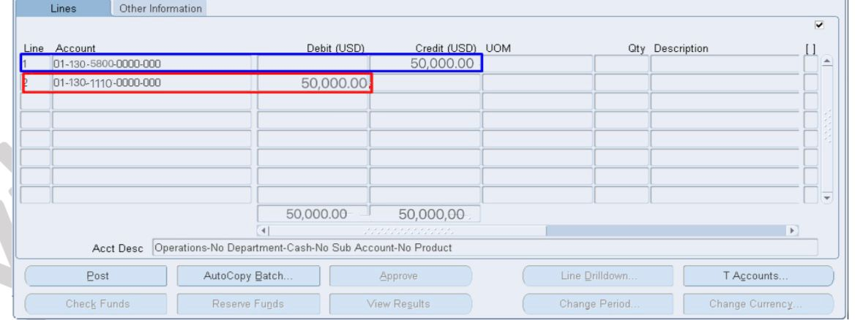

Slide 14
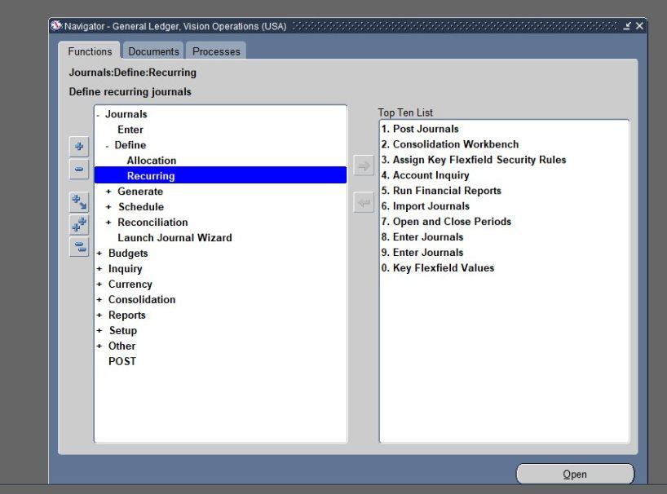
Steps to Implement Recurring Journal Entries:
Identify Recurring Expenses:
List all regular expenses such as rent, utilities, insurance, etc., that require periodic journal entries
Access the Journal Entries Module:
navigate to the General Ledger module
Go to the Journal>Enter>Recurring

Slide 15
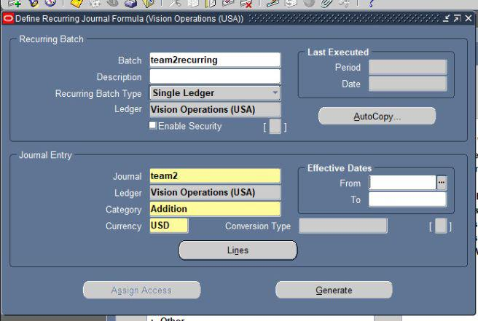
Fill in the necessary details:
choose a name for the batch and the ledger Specify the recurring batch type
Journal Name: Give a unique name for easy identification.
Currency: Specify the currency for the entries choose the appropriate category

Slide 16
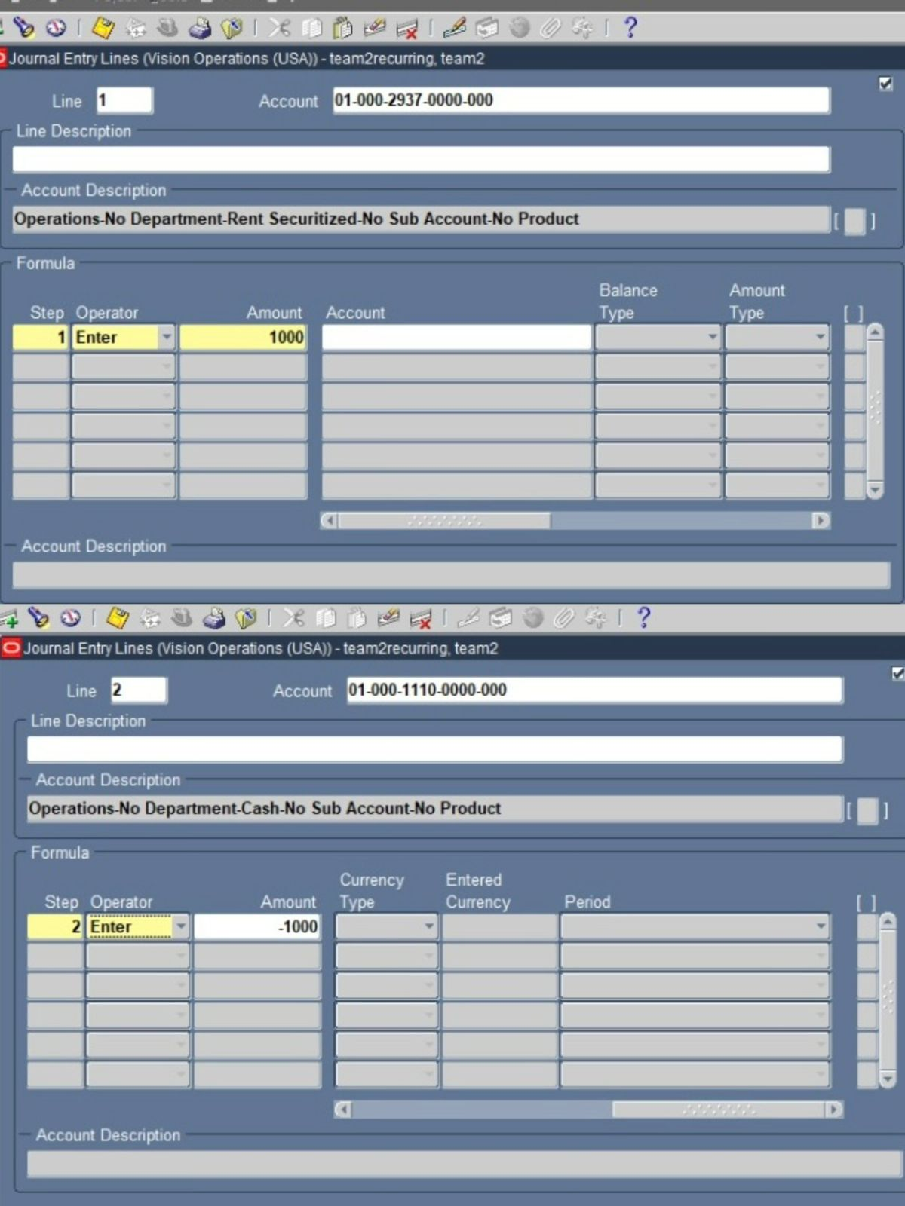
Journal Lines: Enter the accounts to be debited and credited for the expense
enter the values if it is a recurring batchThis type is used for recurring entries with a known future value. We start with the debit side (DR), and its value is positive.
Then we save and add a new line for the credit side (CR), and its value is negative

Slide 17
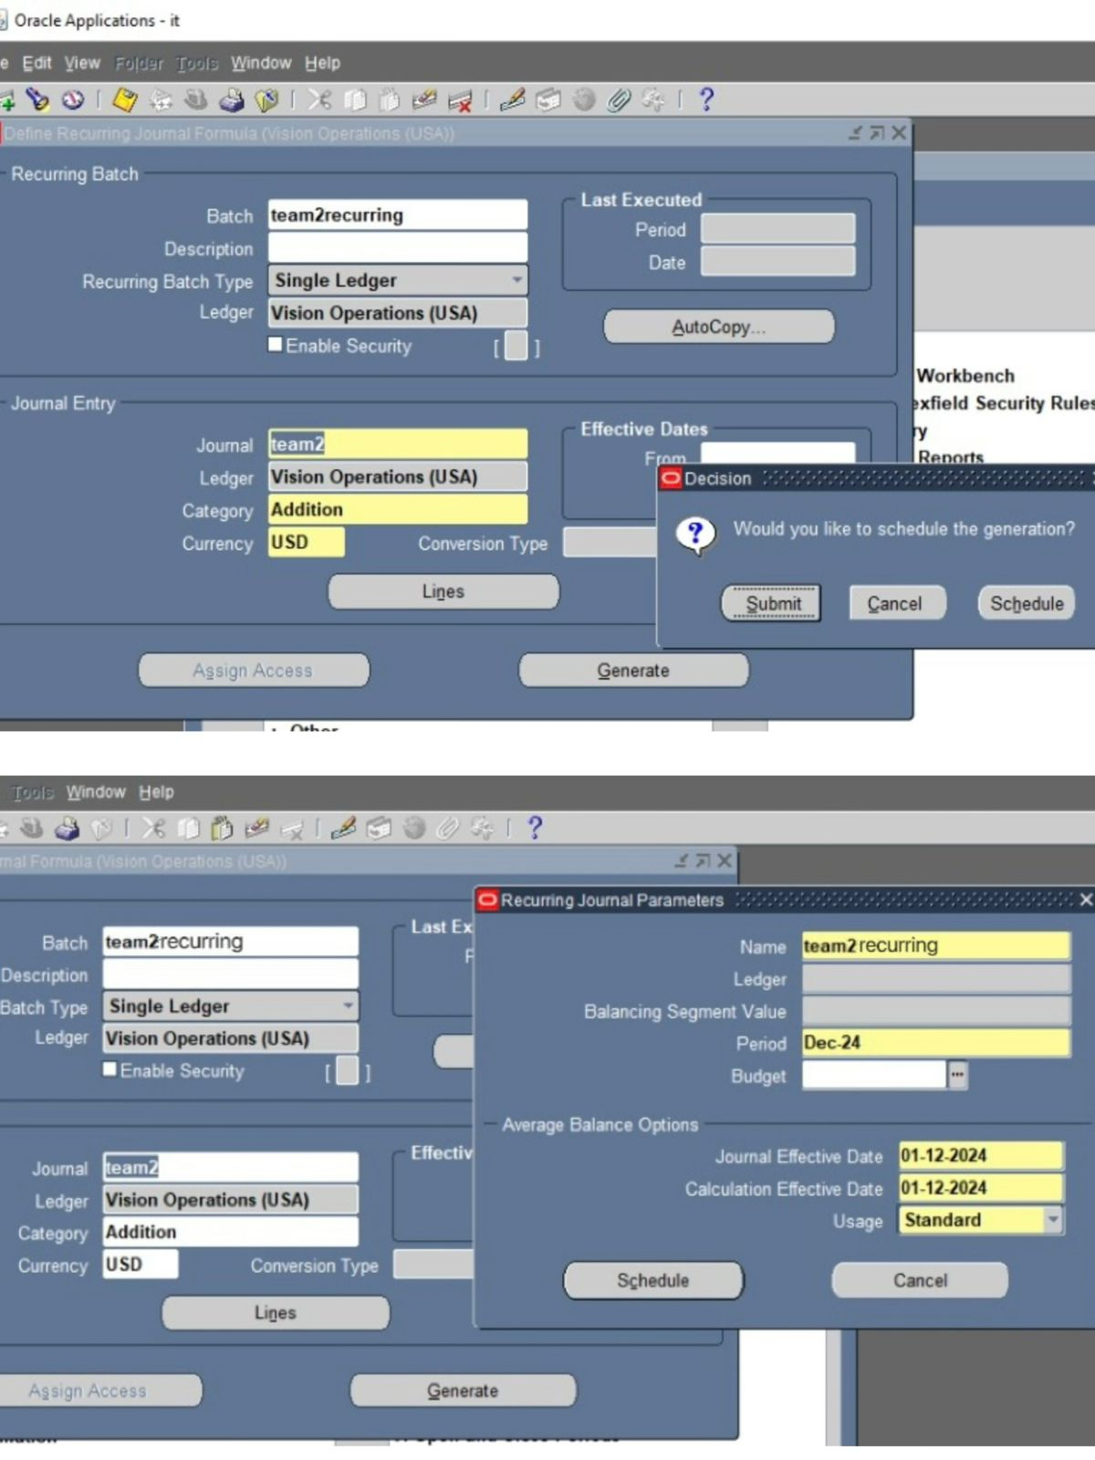
Schedule Recurring Entries:
click on generate and
then
click on schedule choose the period in which we want to create the schedule Choose the start date and end date for the recurring entries And press schedule

Slide 18
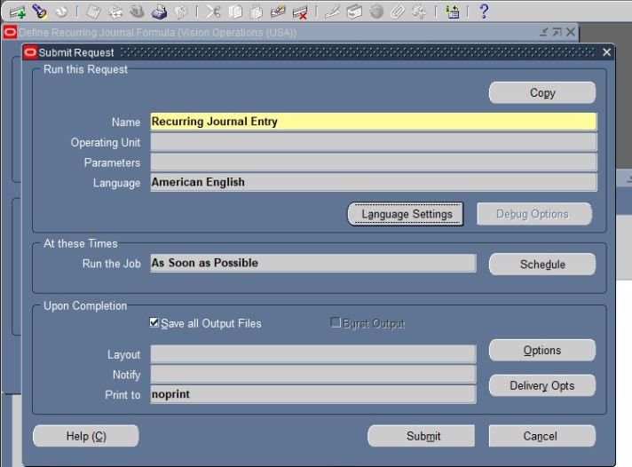
specify when to run the job And press submit

Slide 19
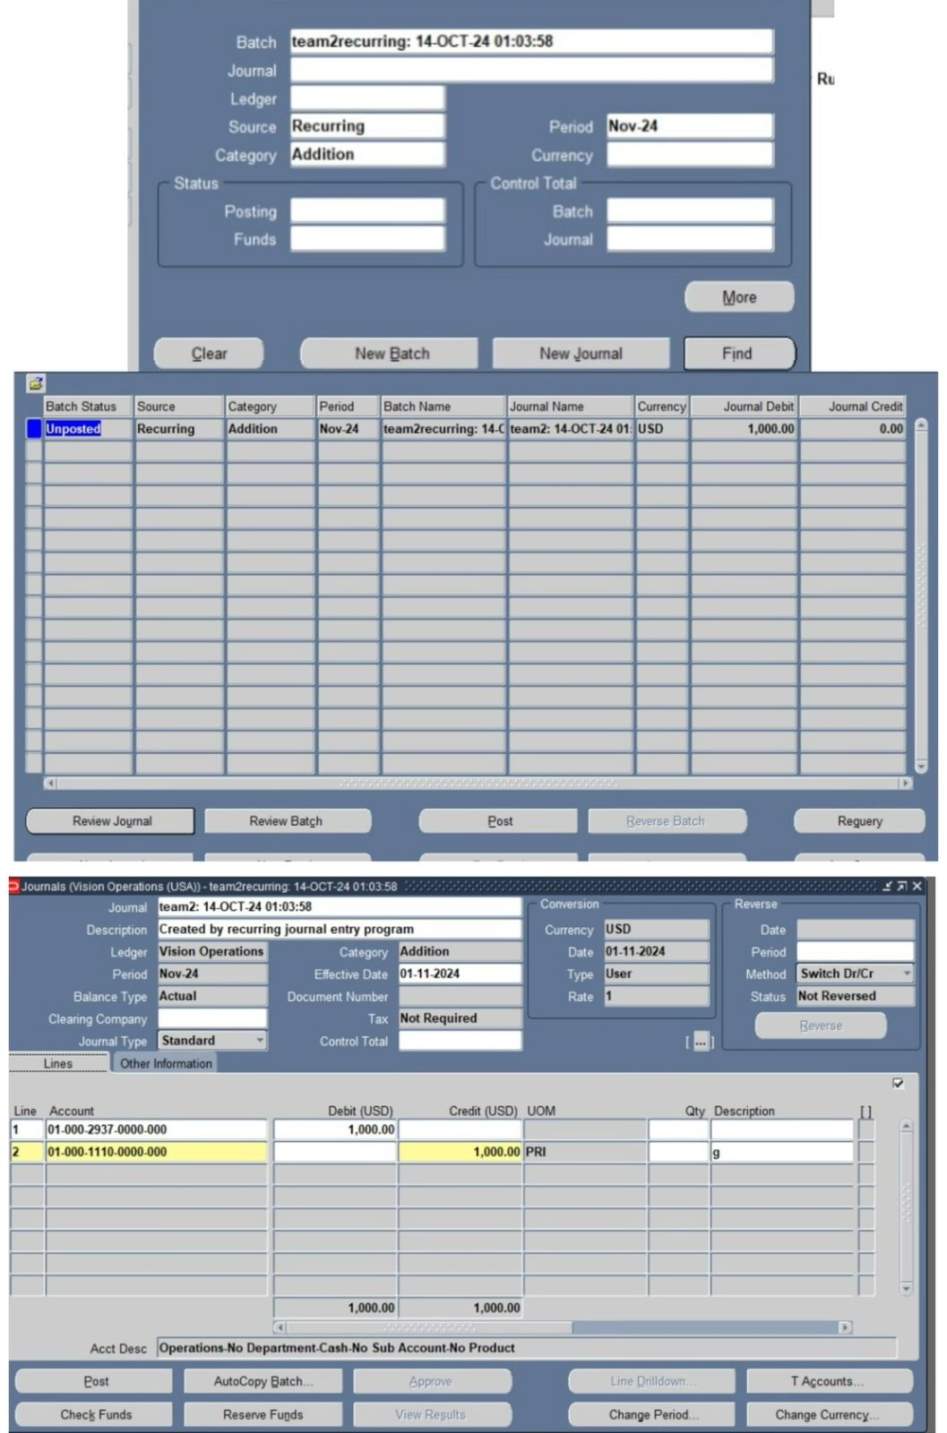
To Review and Save:
Search for the recurring journal by batch name, source,category and period
then
click find Select the batch>click review journal Review the details to ensure accuracy
Then
press post Confirm the posting to the General Ledger

Slide 20
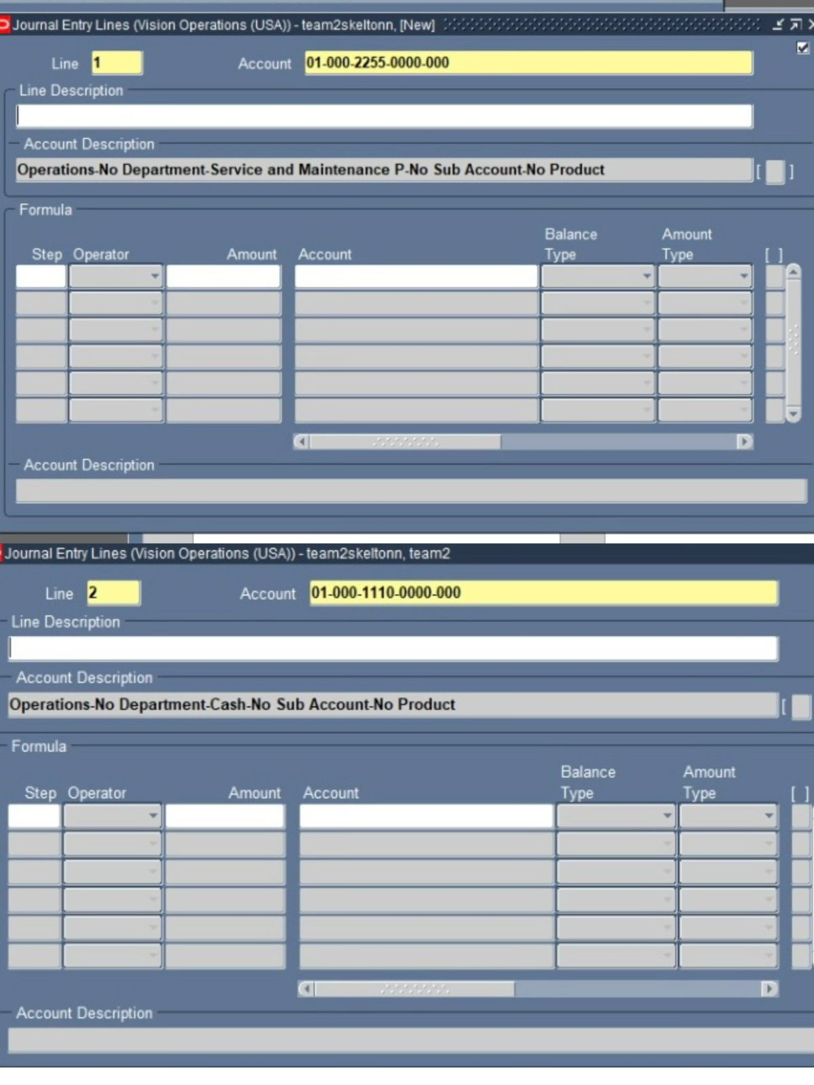
If it is of the skeleton type, we repeat the entries with the accounts only, without values And we follow the same steps as the recurring batch

Slide 21
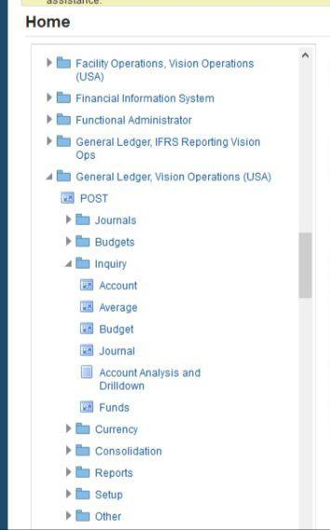
Steps to Implement Inquiry and Drill-Down for Journal Entries in Oracle ERP GL Inquiry allows you to view posted journal entries in the system, giving visibility into the financial transactions recorded.
• Steps :Inquiry>account

Slide 22
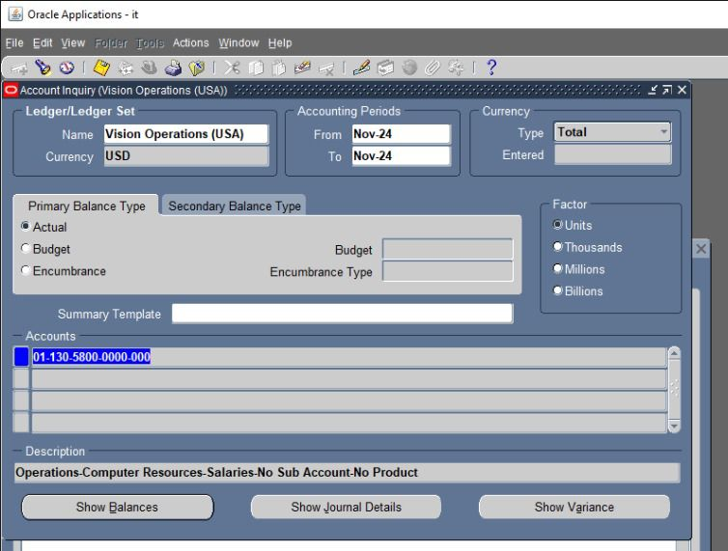
Choose the period you want to Inquiry for it Accounting period :-
set the accounting period ,you want to check the balances in that period Accounts:
Ensure that the account code corresponds to the account you're trying to review balances for
And click Show Balances
This will display the account balances based on the period, account, and balance type selected Review the summary information, including the journal entry number, date, description, and total amounts debited and credited

Slide 23
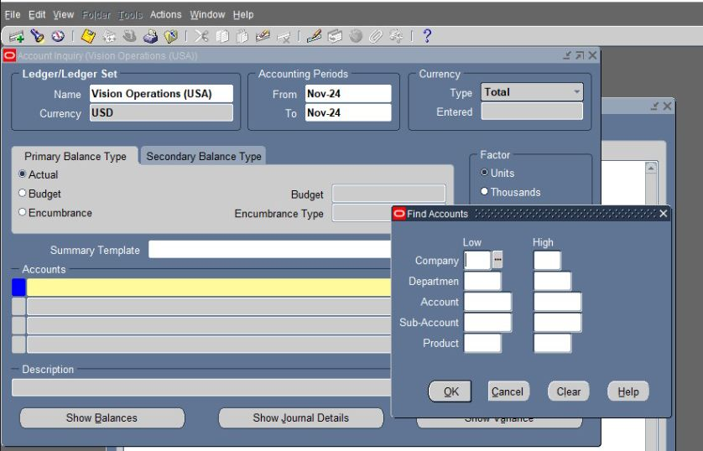
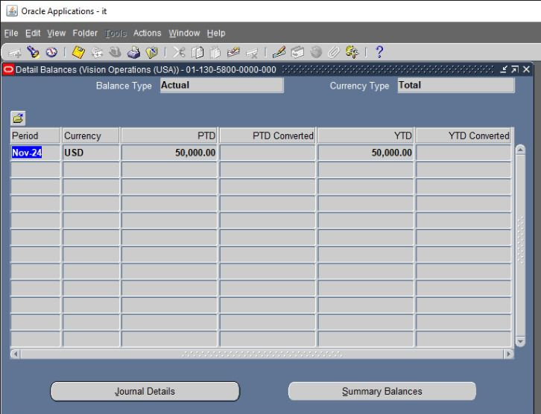
PTD(period to date):
shows the balance for the selected period.
The YTD(year to date): shows the cumulative balance from the beginning of the fiscal year up to the end of the selected period.
Balance Type: It shows Actual balances which means the real financial data
• choose Journal Details to see the journal entries that make up the balance

Slide 24
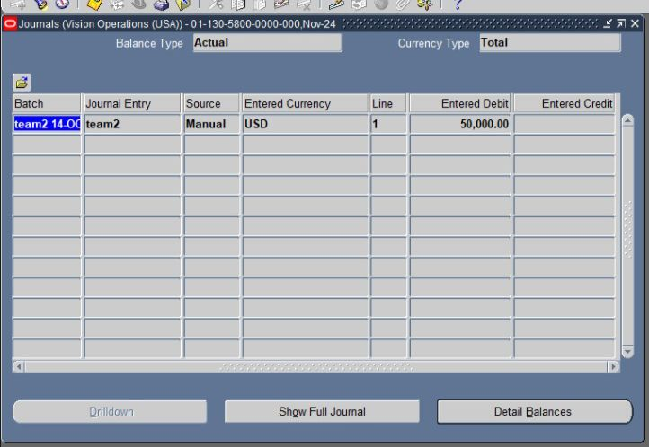
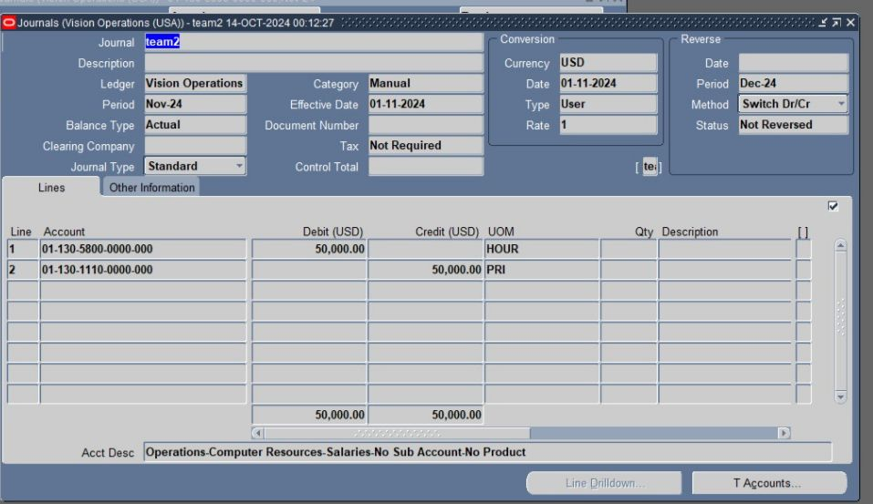
click Show Full Journal To see all information related to the entry and transaction

Slide 25
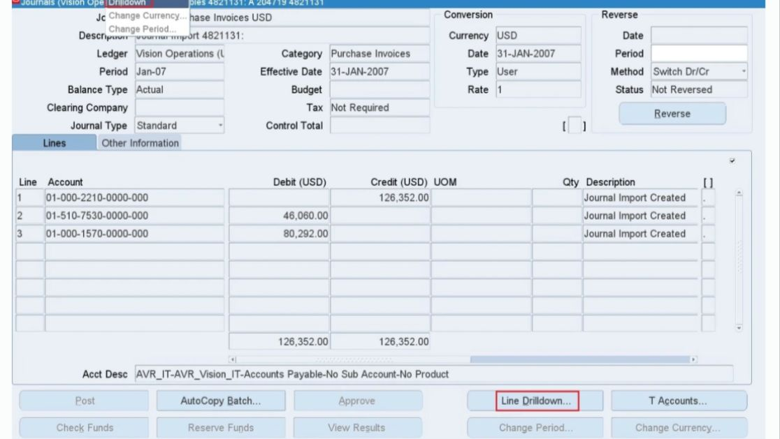
Drilldown functionality enables users to navigate from a Journal in General Ledger to the Subledger Journal Entry in SLA and from there to the transaction which has resulted into that journal.
• select the journal line and click on Line Drilldown

Slide 26
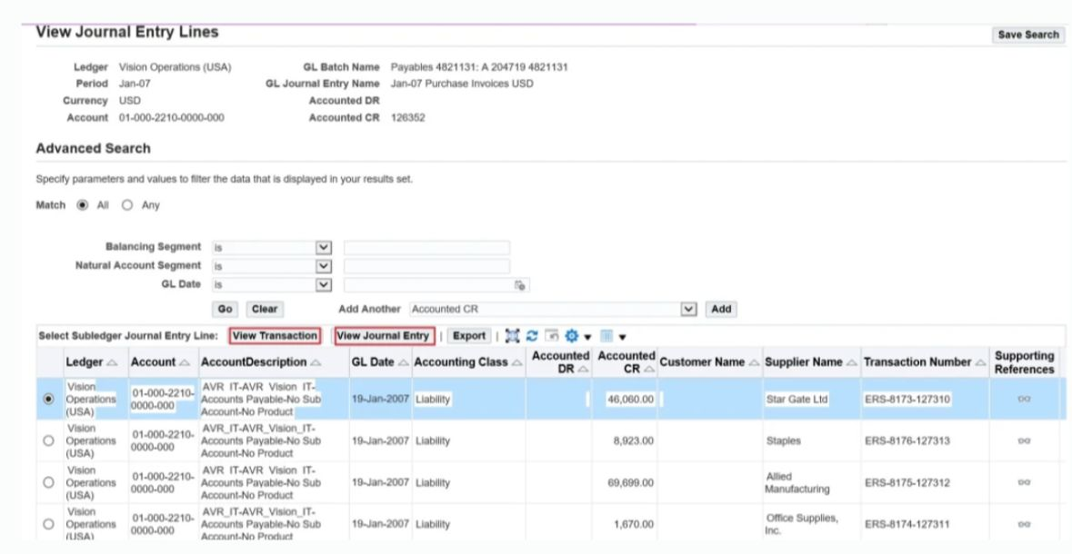
You can View Transaction OR View Journal Entry View
Transaction will take us to the Subledger Transaction form.

Slide 27
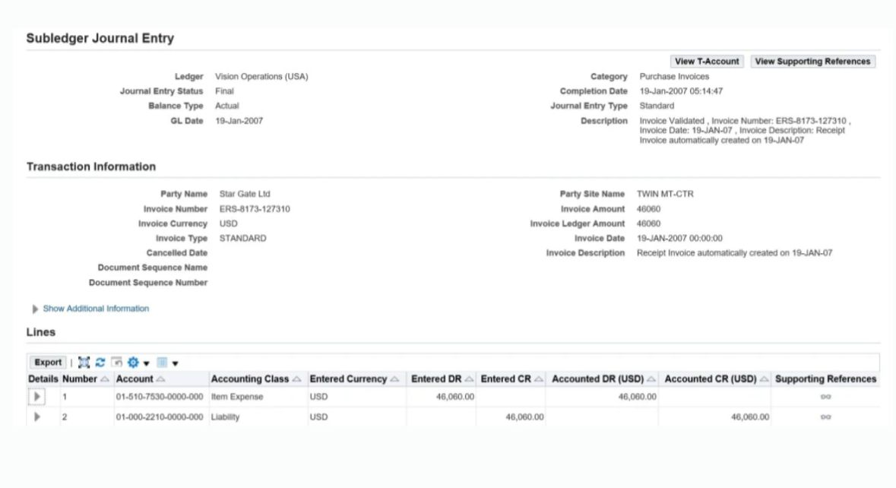
View Journal Entry’ will take to the Subledger Journal Entry details.
• View Journal Entry has three parts to it:
Transaction Information
Additional Information L
ine Details
Drill down action will provide additional information such as:
Individual account lines -debit and credit-
Account descriptions
Related transaction details
Any attachments or notes associated with the entry

Slide 28

Managing GL Reports and Financial Data

Slide 29
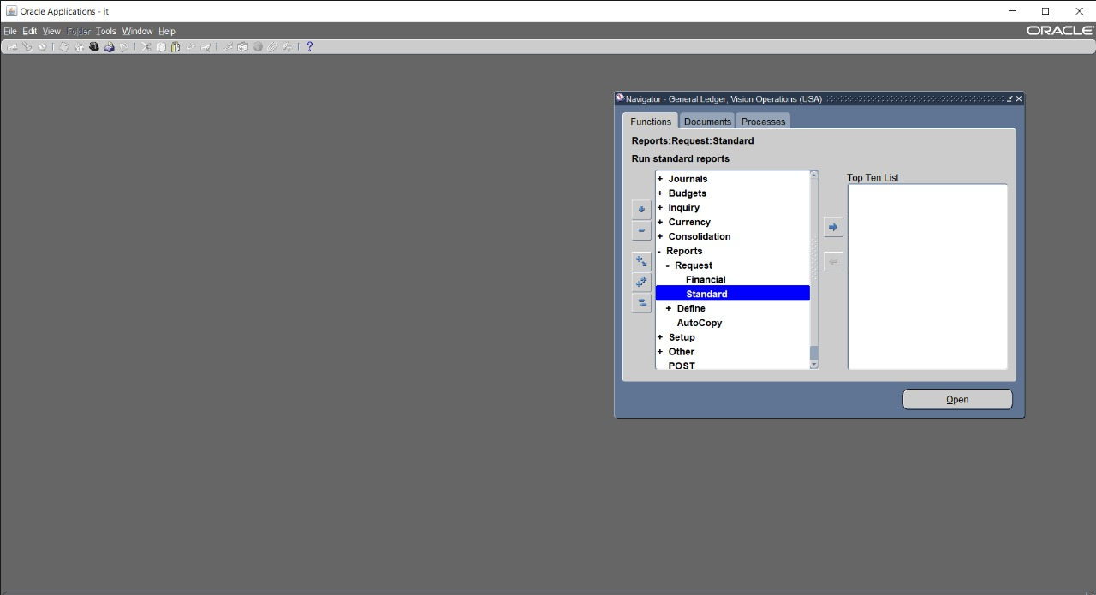
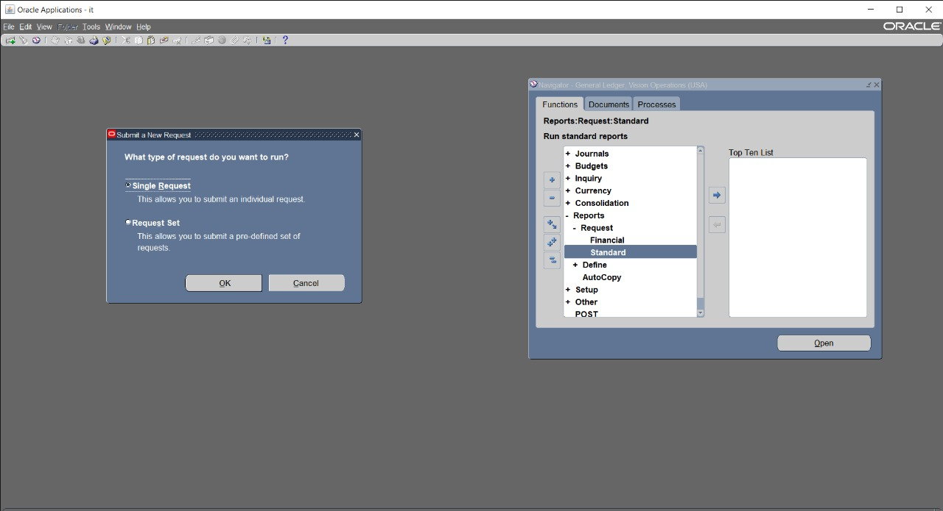
1. Run Standard Financial Reports:
when we want to run standard report press reports then request thenstandard
after standard then apper screen that determind if you want submit single request or set of request

Slide 30
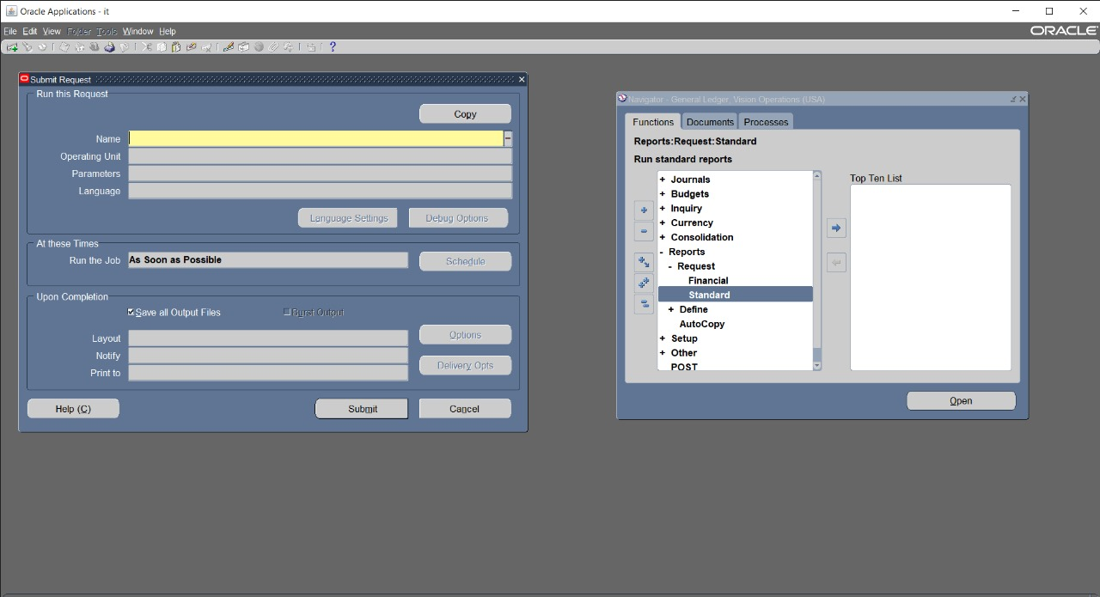
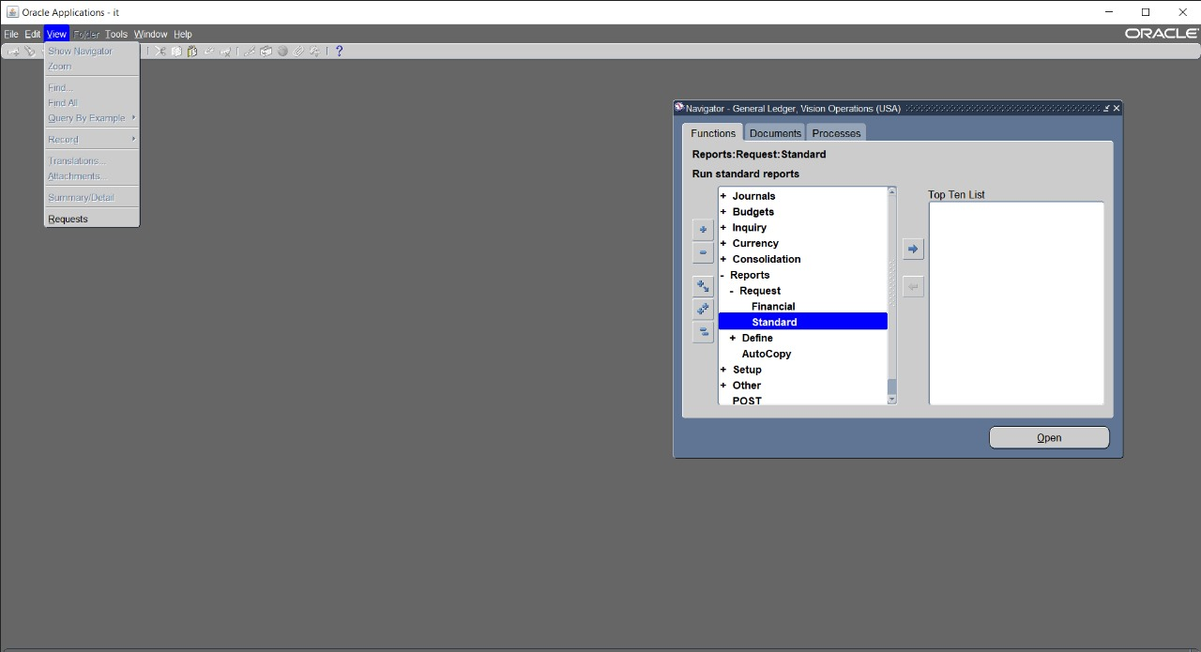
then appear screen that contain the name of the reports
if we want to see the reports press view then request

Slide 31
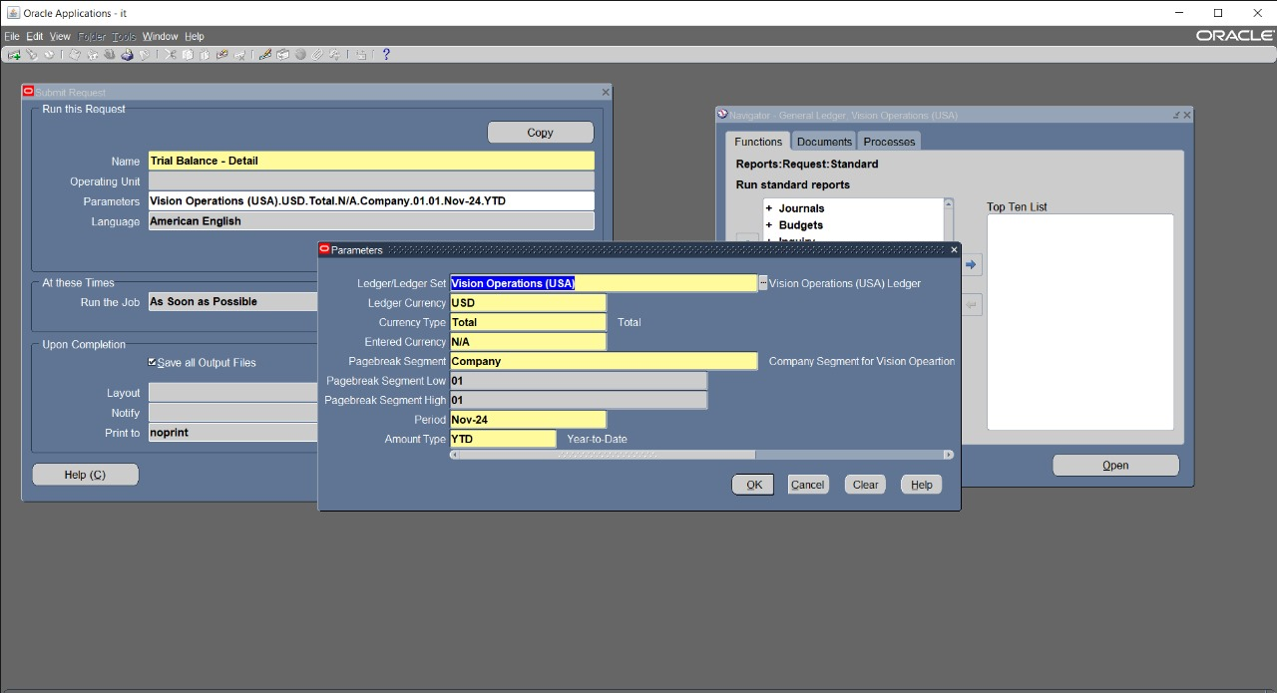
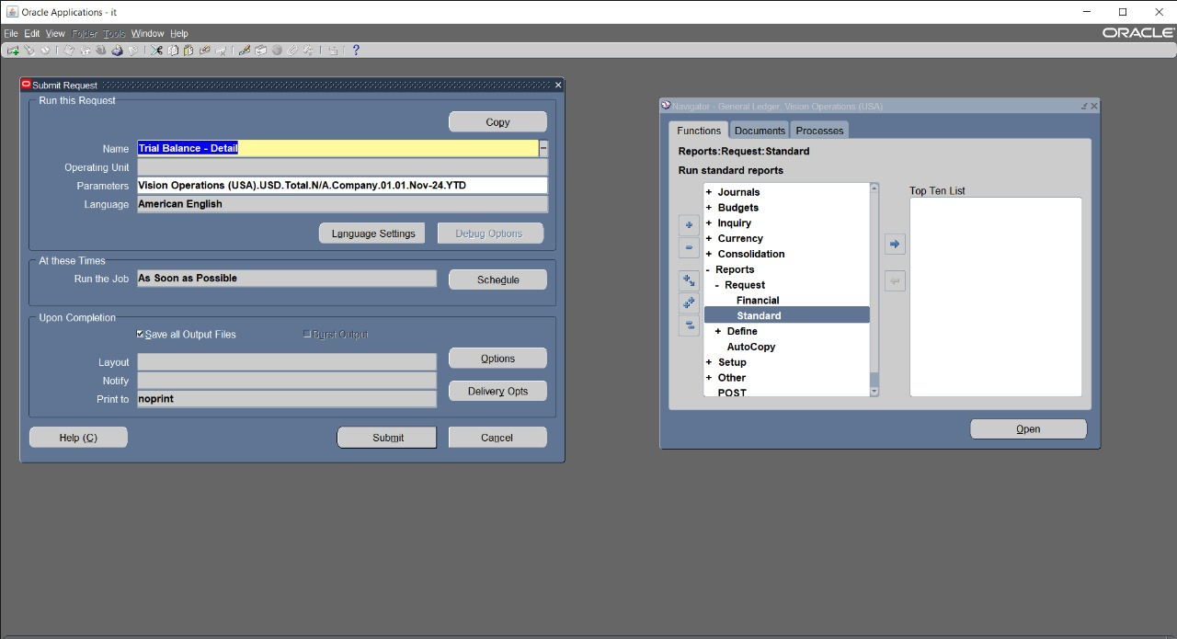
when we choosed the name of reports then appear parameters that contain ledger name and currency and tyoe of segements and period and amount type PTD or YTD or PTD
when we finished parameters then press submit to run trial balance report

Slide 32
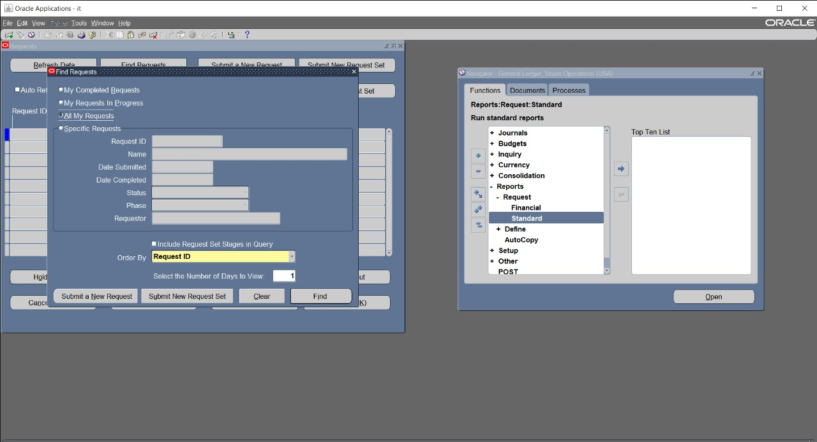
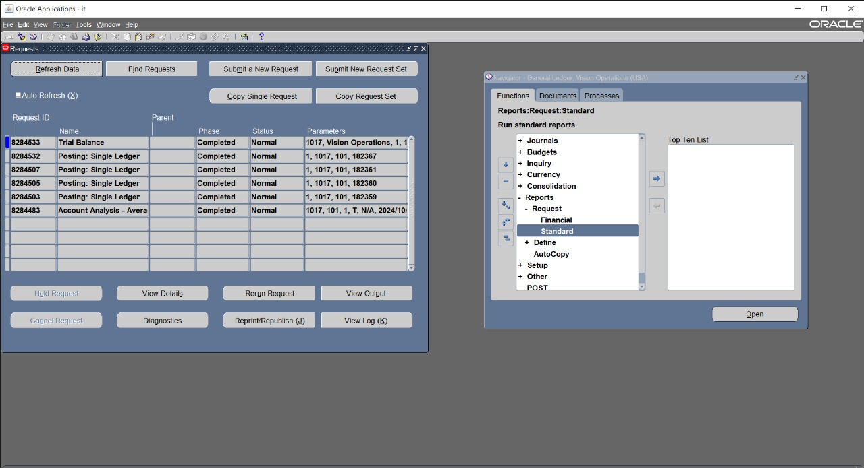
when pressed view then request apear find request and press find all my
request
after press find all my request then appear trial balance press view
output

Slide 33
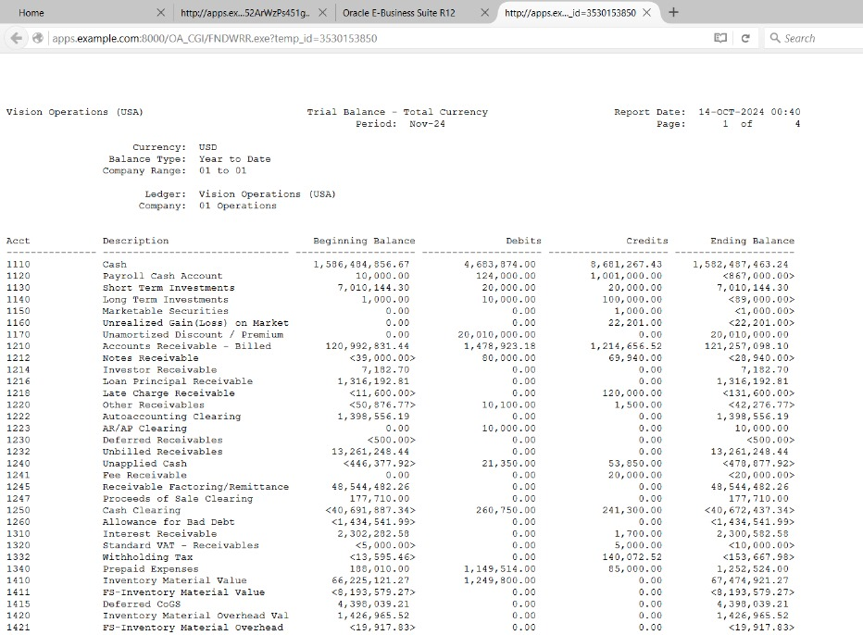
then appear trial balance

Slide 34
Create and Run Ad-Hoc Reports
Ad-hoc reports are customized reports generated for specific needs like financial analysis or review.
Here's how to approach this in Oracle ERP: Steps to Create and Run Ad-Hoc Reports:
Log in to Oracle ERP System: Navigate to the 'General Ledger' module.
Access the Reporting Module: Go to 'Reports > Financial' and select 'Ad-Hoc Reports’.
Select the Parameters: Define time period, account segments, departments, and data type.
Choose the Report Format: Use standard report formats or customize.
Run the Report: Click 'Run' and generate the report.
Export the Report: Export the report to Excel or PDF.
Review and Analyze: Review the report for any inconsistencies.

Slide 35
Account Reconciliation
Account reconciliation involves comparing financial records (General Ledger) with other financial records (sub-ledgers) to ensure accuracy.
Here's how to perform reconciliation in Oracle ERP:
Steps for Account Reconciliation:
Prepare the Data: Gather the relevant sub-ledger reports (e.., Accounts Payable).
Access General Ledger (GL) Inquiry: Navigate to the 'General Ledger' module and select 'GL Inquiry’.
Select Account Balances to Reconcile: Choose specific accounts to reconcile (e.g., Cash, AR, AP).
Compare GL and Sub-Ledgers: Compare the balances from the GL to sub-ledger reports.
Identify Discrepancies: Investigate any differences between GL and sub-ledger balances.
Adjust Entries: Post adjusting journal entries if necessary.
Generate Reconciliation Report: Create a summary report after reconciliation.

Slide 36
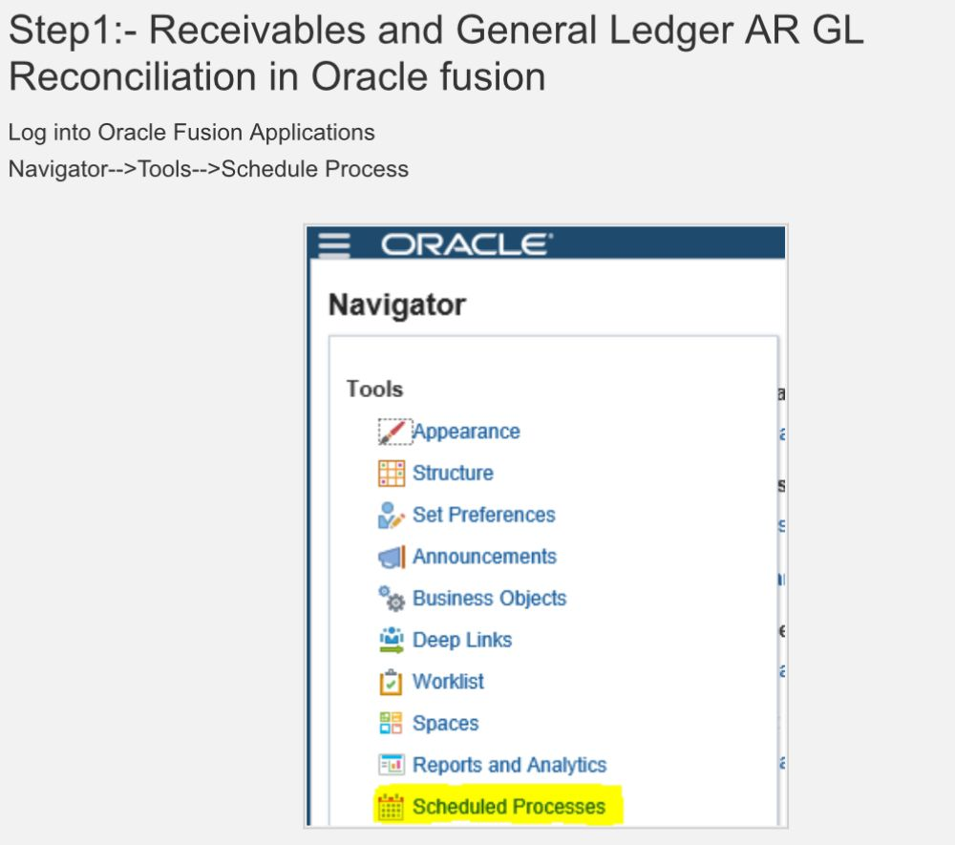
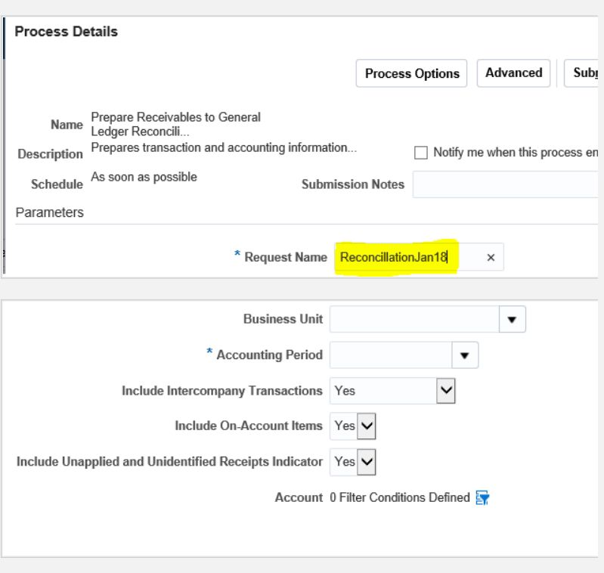
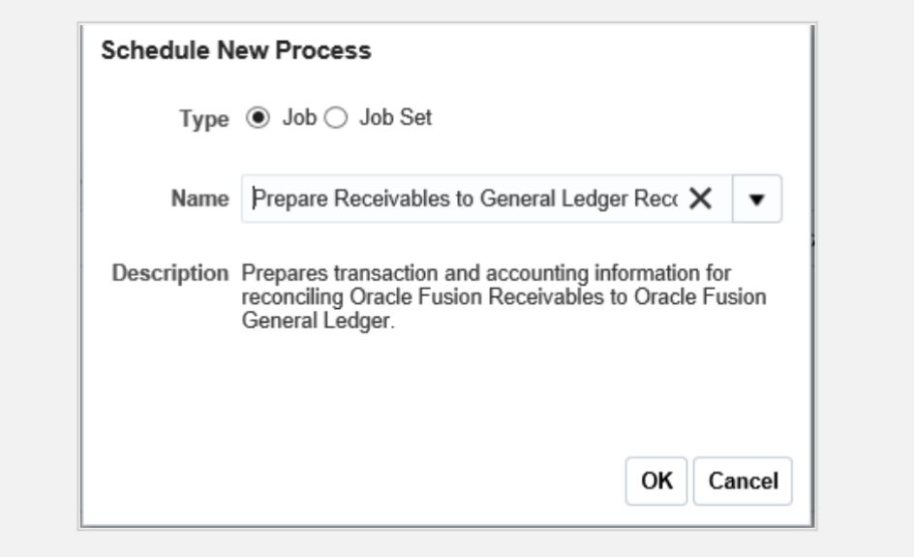
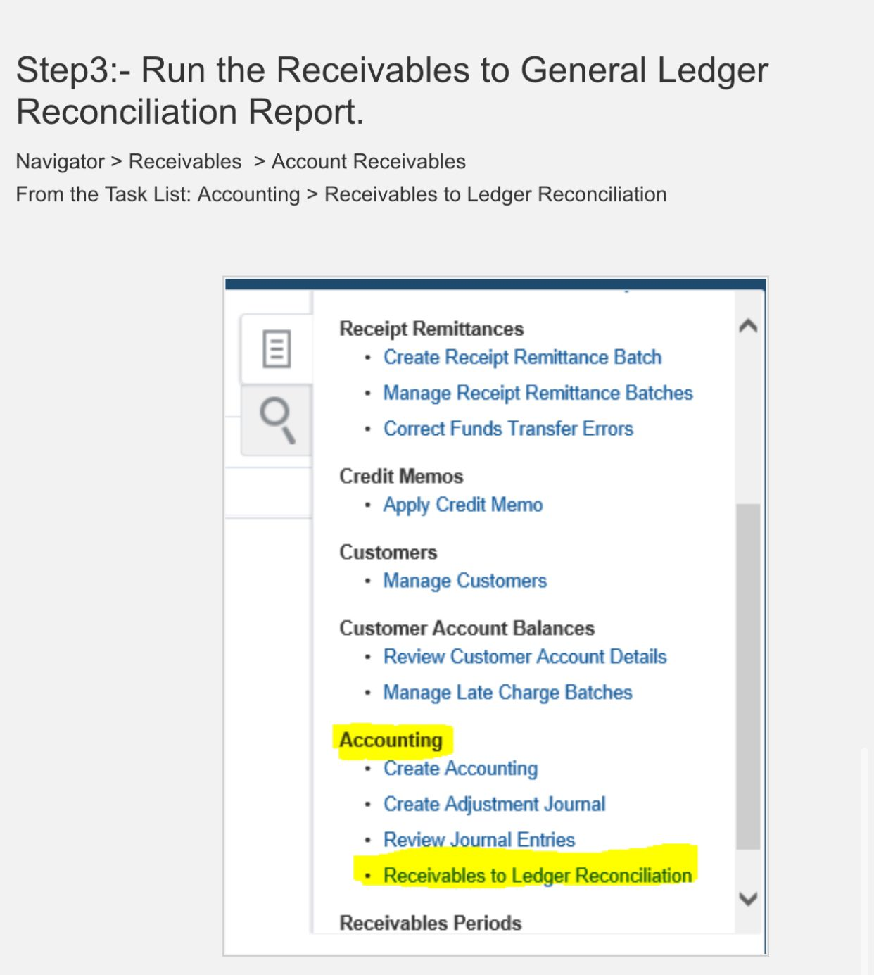
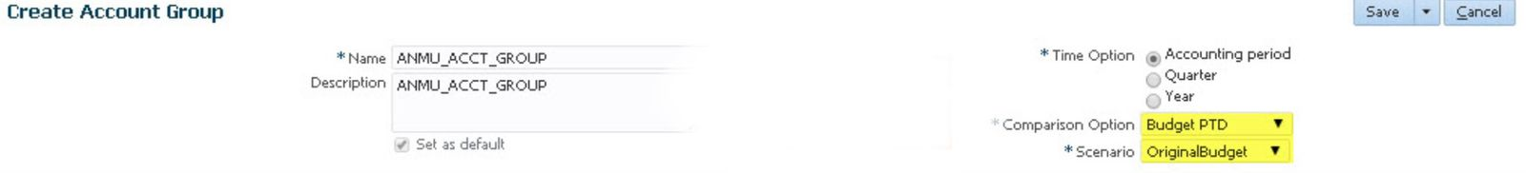

Slide 37
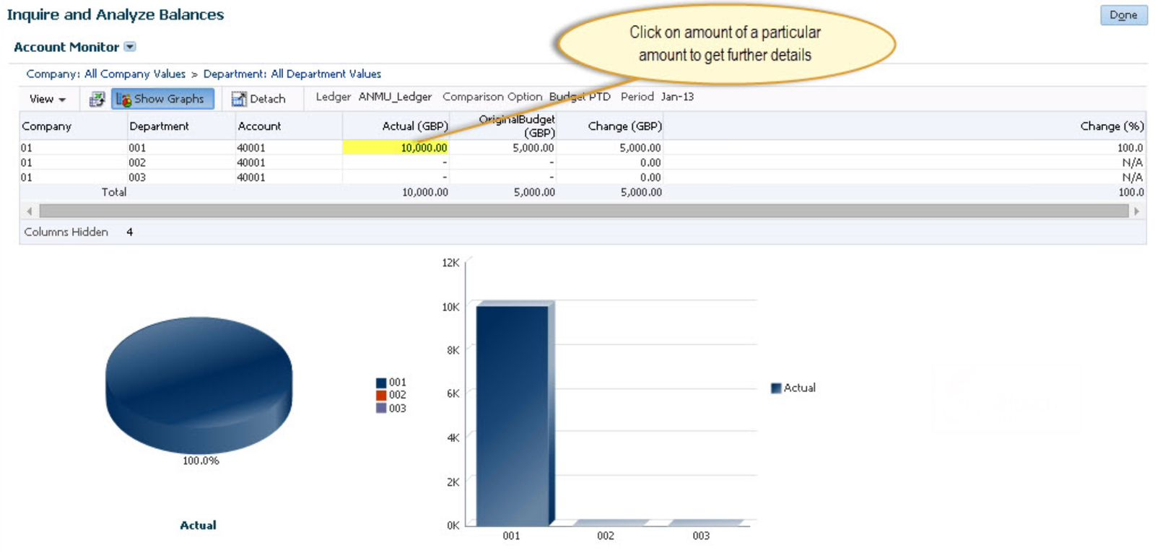
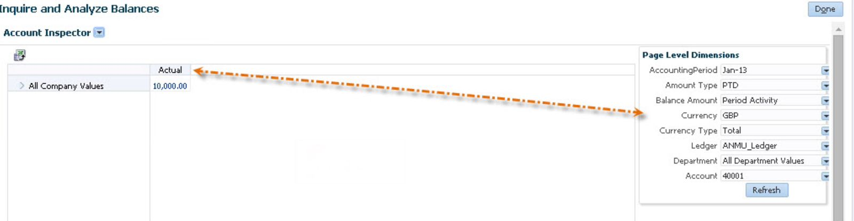

Slide 38
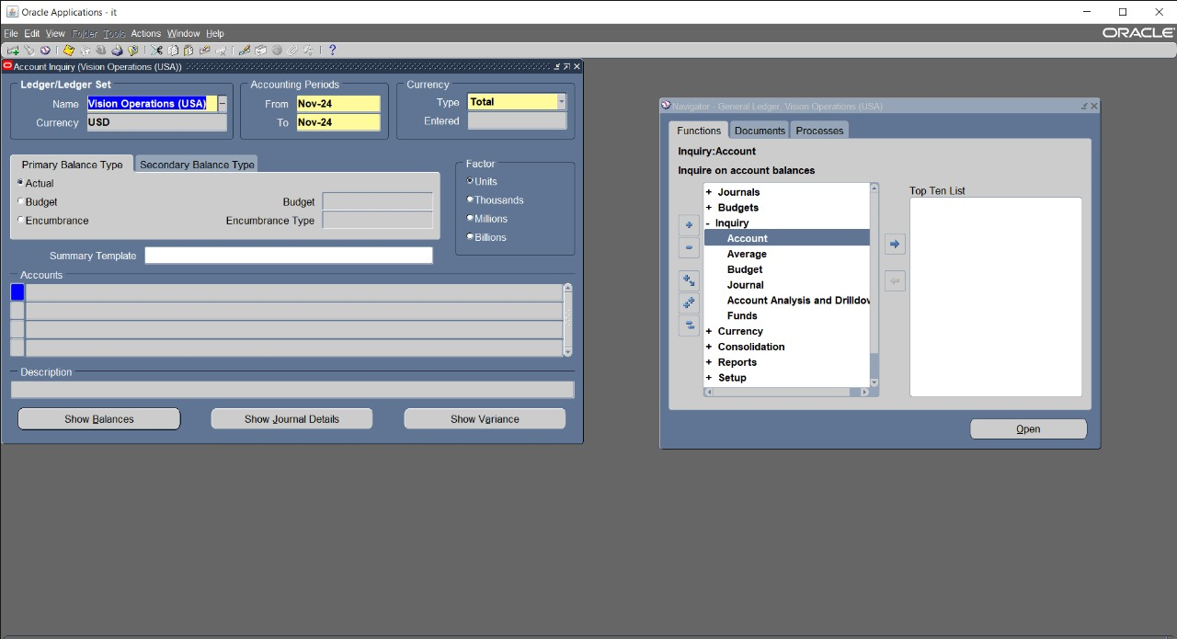
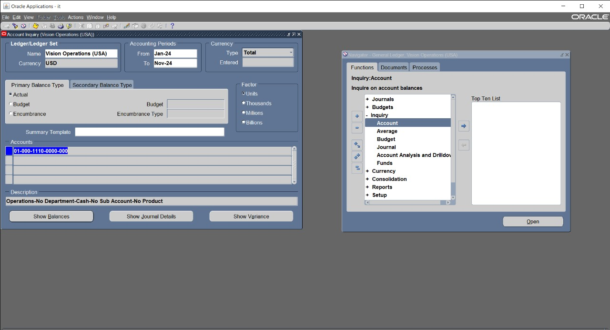
View and Analyze Account Balances
if you want to view account balance go to account then inquiry and appear this window
then insert the account you want to show balance and press show
balance

Slide 39
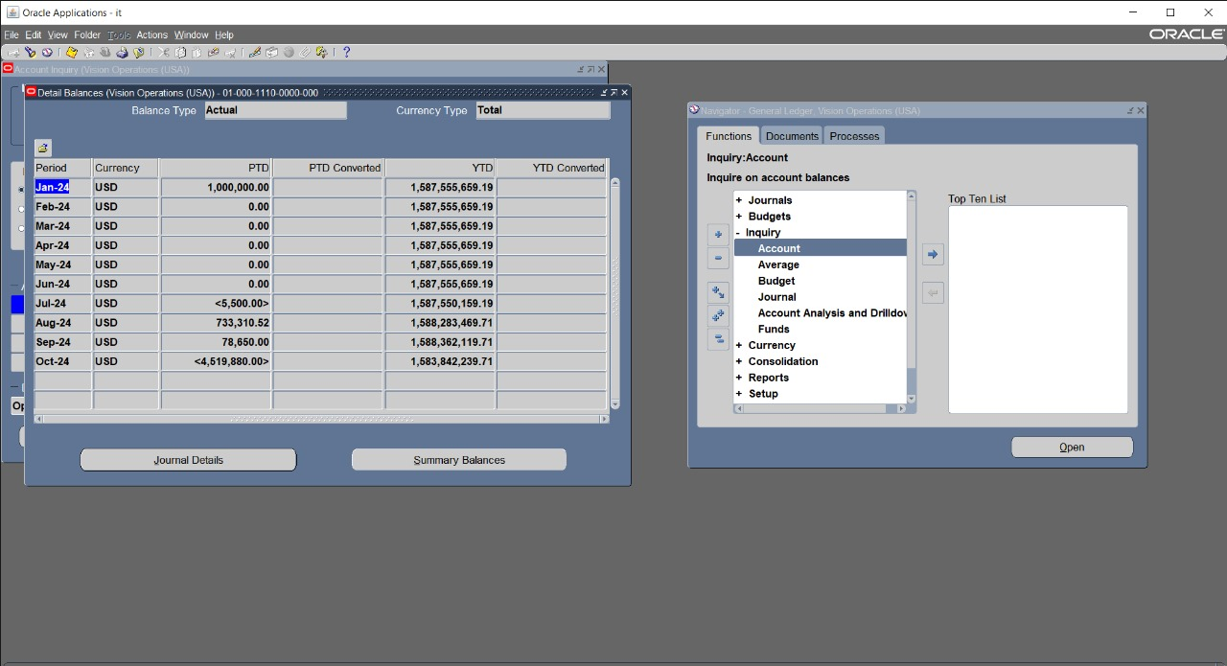
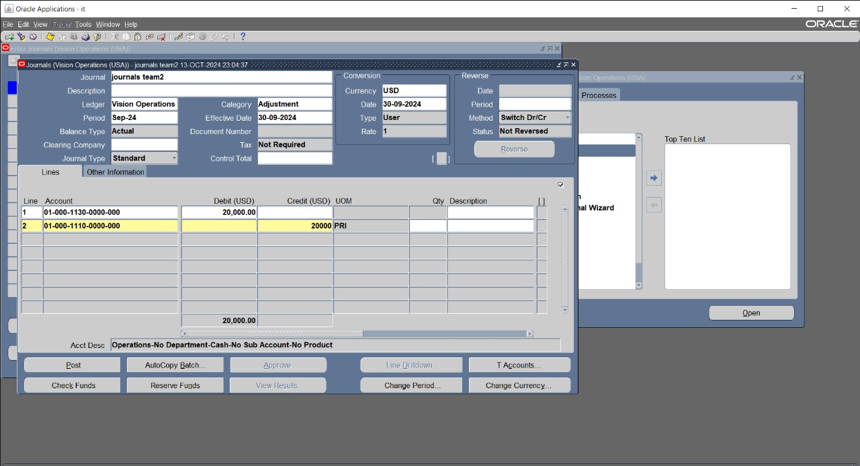
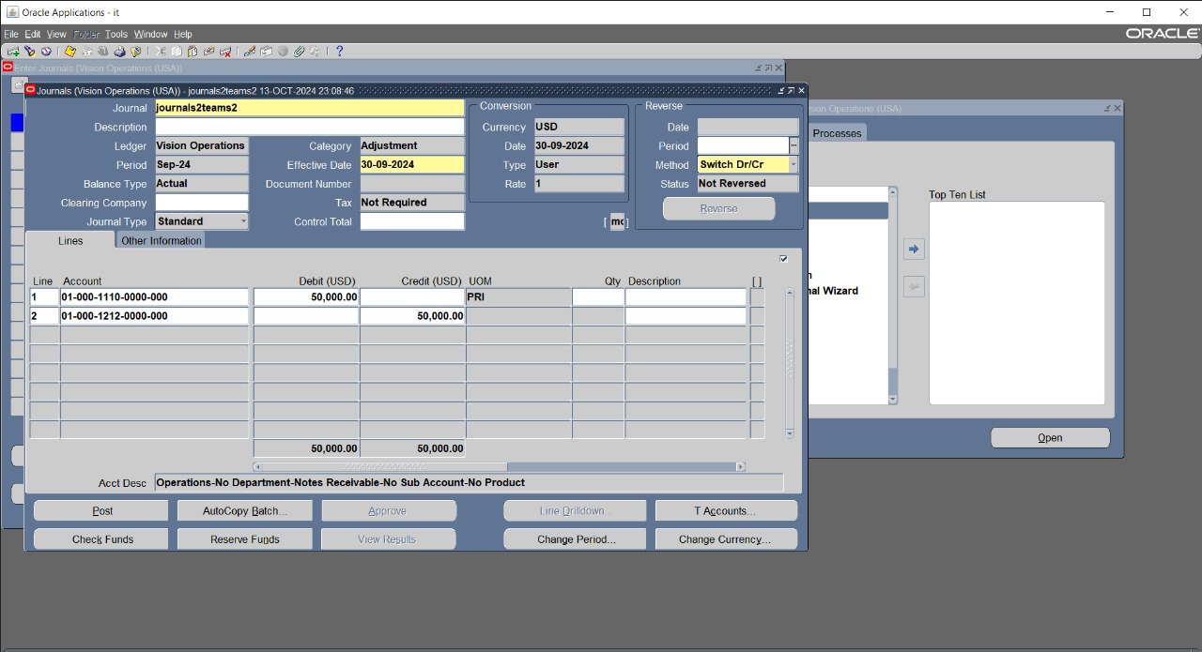
then appear the balance of account in the spasific period you want to show balance in it
then create journal in septemper to show how effect to the balance in septemper
create another journal in septemper

Slide 40
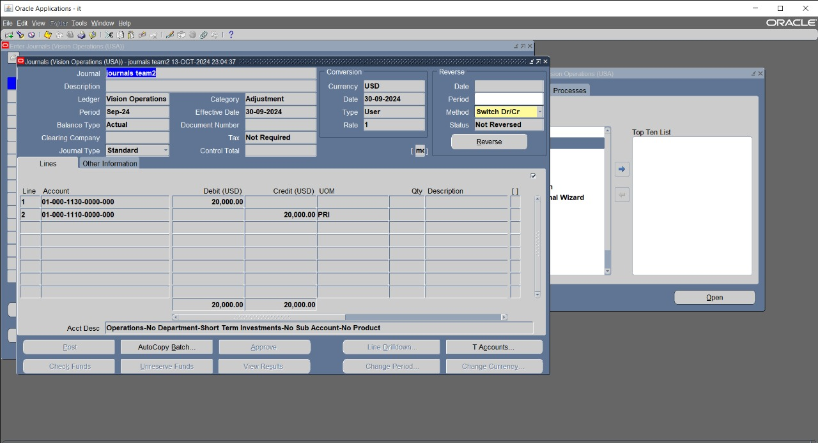

post the first journal
post another journal

Slide 41

Period Closing and Budget Monitoring

Slide 42
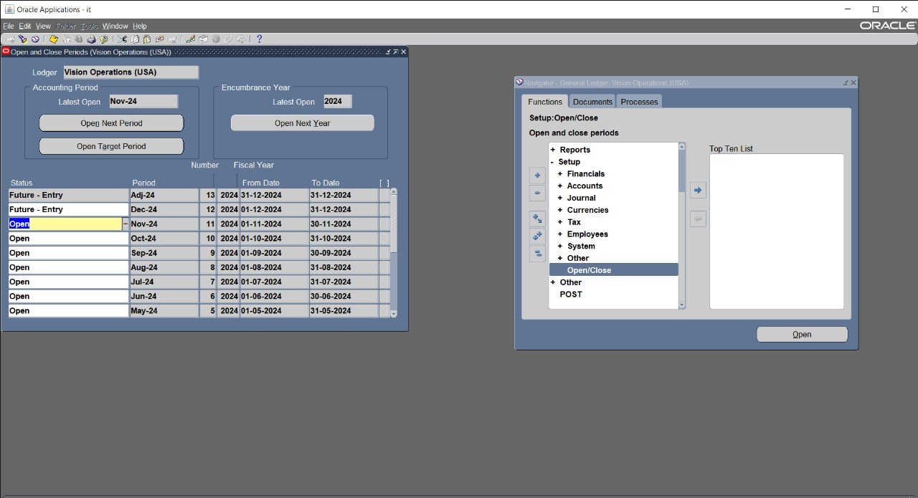

Open and Close Accounting Periods
open period press setup then open_close period and choose open next period
nov24
create journal in this period nov24

Slide 43


post journal that
i created
in this period
nov24
create and post another journal in that period
nov24

Slide 44
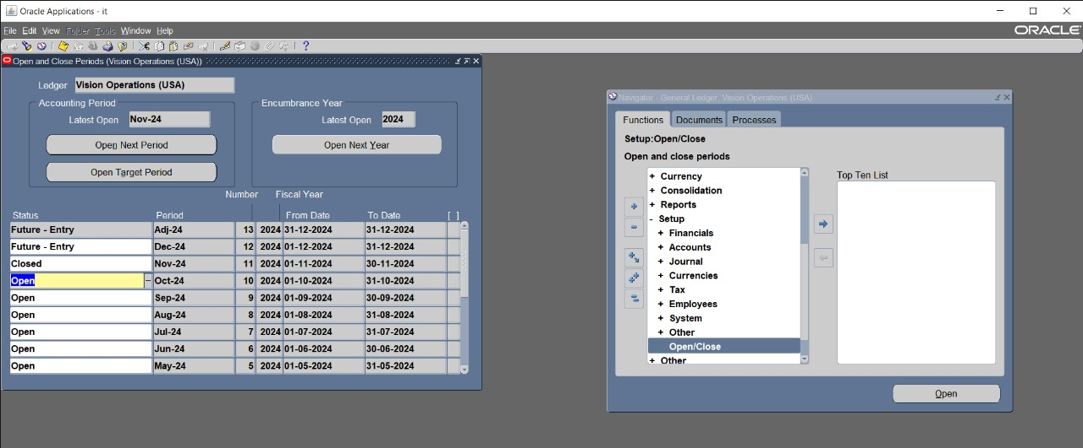
if we don,t have any journals in that period nov24 close this period

Slide 45
Month-End Close Process.
To successfully complete the month-end close process by reviewing unposted journals, running necessary reports, and ensuring the accuracy of the General Ledger (GL). Step-by-Step Solution for Month-End Close:
Step 1: Access the Month-End Close Module
Login to Oracle ERP.
Navigate to the General Ledger (GL) or Period Close section.
Step 2 : Review Unposted Journals
Open the Unposted Journals Inquiry screen.
Review each unposted journal and ensure that they are complete and ready for posting.
Post valid journals after reviewing.
Step 3: Run Month-End Close Reports
Run the Trial Balance Report to ensure debits and credits are in balance.
Reconcile sub-ledgers to the GL.
Review accrual and adjustment reports.
Generate the Income Statement, Balance Sheet, and Cash Flow Statement.
Step 4: Ensure Sub-ledgers are Closed
Close sub-ledgers after all reconciliations.
Review reports to confirm the closure of sub-ledgers.
Step 5: Perform the Final GL Close
Run the final close process of the GL.
Lock the accounting period to prevent further postings.

Slide 46
Budget Monitoring
A. Viewing and Comparing Budget vs. Actual Data:
Log in to Oracle ERP: Use your credentials to access the system.
Navigate to the Budget Section: Look for the budget or financial reporting section in the dashboard.
Select the Report: Find the report option for "Budget vs. Actual".
Choose the Time Period: Specify the period you want to analyze (e.g., monthly, quarterly).
Run the Report: Click on the "Run Report" button to generate the report.
Analyze the Results: Review the report to compare budgeted figures with actual expenditures.
B. Running Budget Reports:
Go to the Reporting Section: Access the financial reports menu.
Select Budget Reports: Find and select the appropriate budget report options.
Set Report Parameters: Define the parameters such as the fiscal year, department, or project.
Generate the Report: Click on the "Generate" or "Run" button to create the report.
Analyze Variances: Review the report to track spending and identify variances.

Slide 47
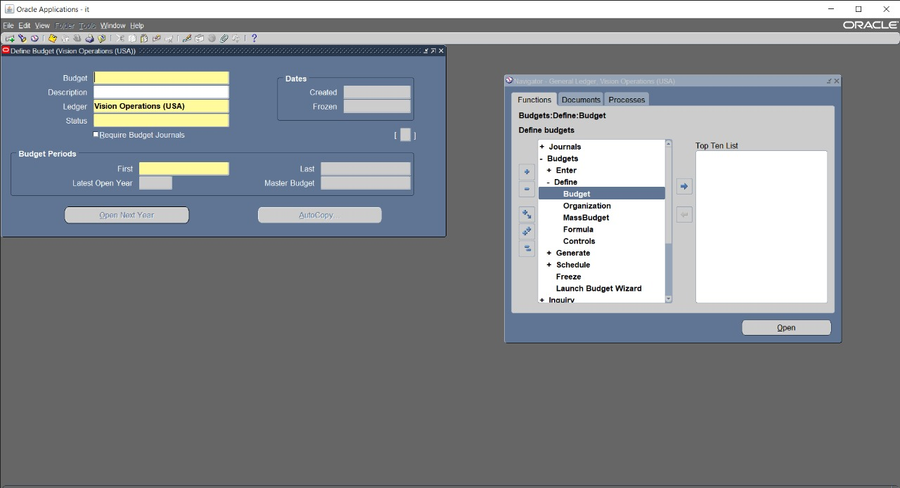
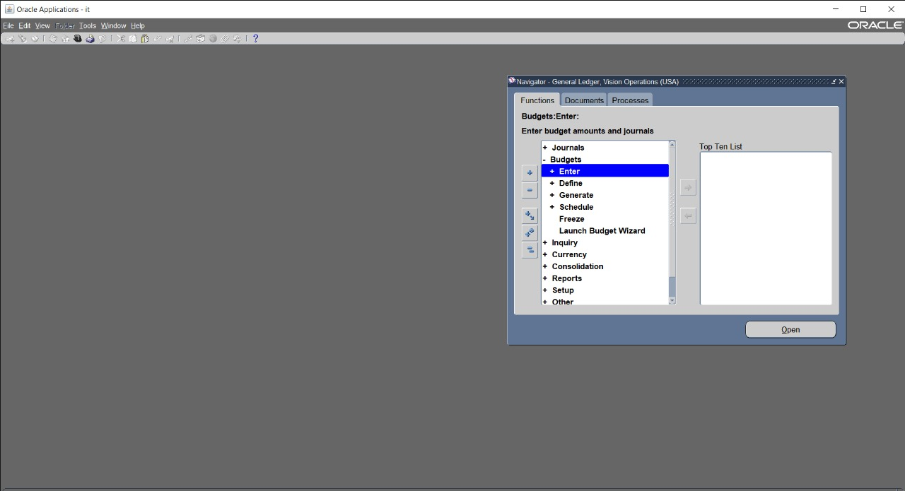



Slide 48
Generate Final Financial Statements
A. Running the Final Income Statement:
Navigate to Financial Reports: Go to the financial reporting section.
Select Income Statement: Look for the option labeled "Income Statement".
Specify the Reporting Period: Choose the time frame for which you want the income statement.
Run the Report: Click "Run" to generate the final income statement.
Review the Report: Ensure that all revenues and expenses are accurately reflected.
B. Running the Balance Sheet:
Find the Balance Sheet Option: In the same financial reporting section, locate the "Balance Sheet" report.
Set the Time Period: Choose the same period as the income statement for consistency.
Generate the Report: Click "Run" to create the balance sheet.
Verify Accuracy: Check that all assets, liabilities, and equity are accurately recorded.
C. Ensuring Reports Reflect All Journal Entries and Adjustments:
Review Journal Entries: Ensure that all journal entries for the period have been entered in the system.
Check Adjustments: Make sure any adjustments (e.g., corrections, accruals) have been processed.
Cross-verify Reports: Compare the reports against your journal entries to confirm that they align.

